Slide 1
What to do with the hybrid trolls?
Safety First!

Slide 2
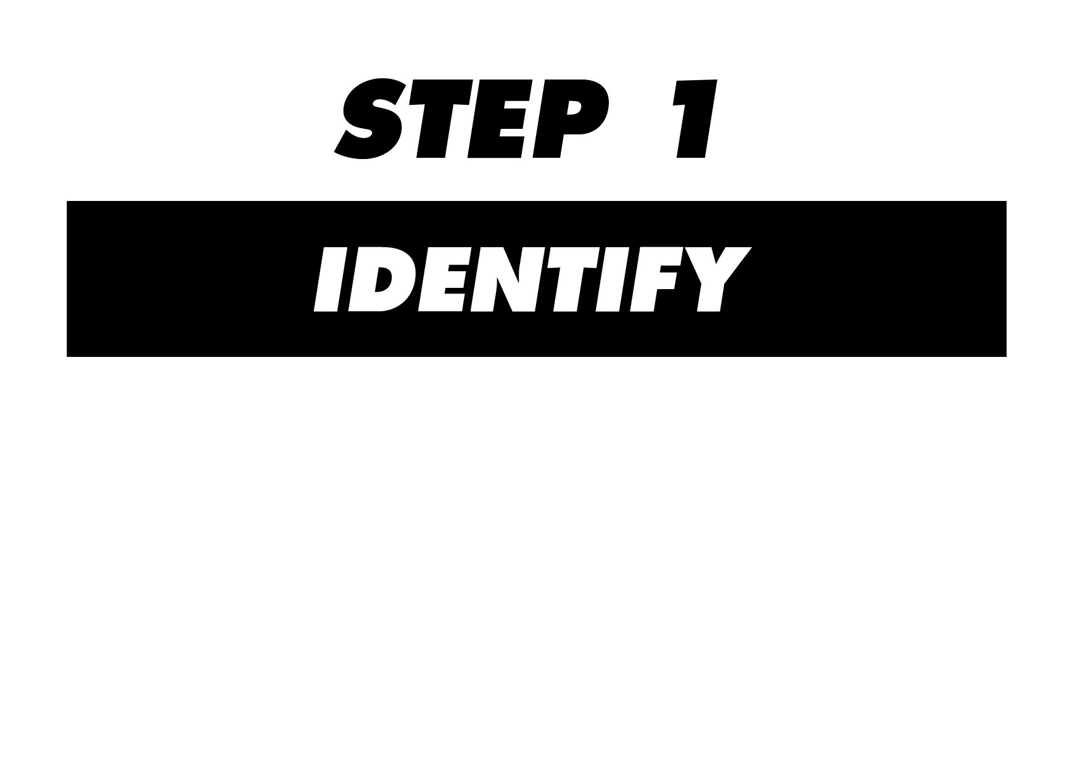
Comment is too long (more than 4 lines)
Comment is “out of context”
Commenter is recognised as a troll by other commenters
Commenter is openly aggressive and hostile
Commenter is semi-literate
If you have found one hybrid troll, look for others – they typically post in groups (or one troll uses different identities and message types).
NB – even if all these factors are present, they do not prove conclusively that the commenter is a hybrid troll.

Slide 3

Ask a question – classic trolls typically respond, responses from hybrid trolls are near impossible because of language issues.
Google them:
• Same message, different profiles
• Same message, many repetitions (same comment posted to articles on different subjects; over a long period – even as much as a year)

Slide 4

Via a comment, for the knowledge of more vulnerable internet users
If the troll has already been labelled, proceed to step 4

Slide 5
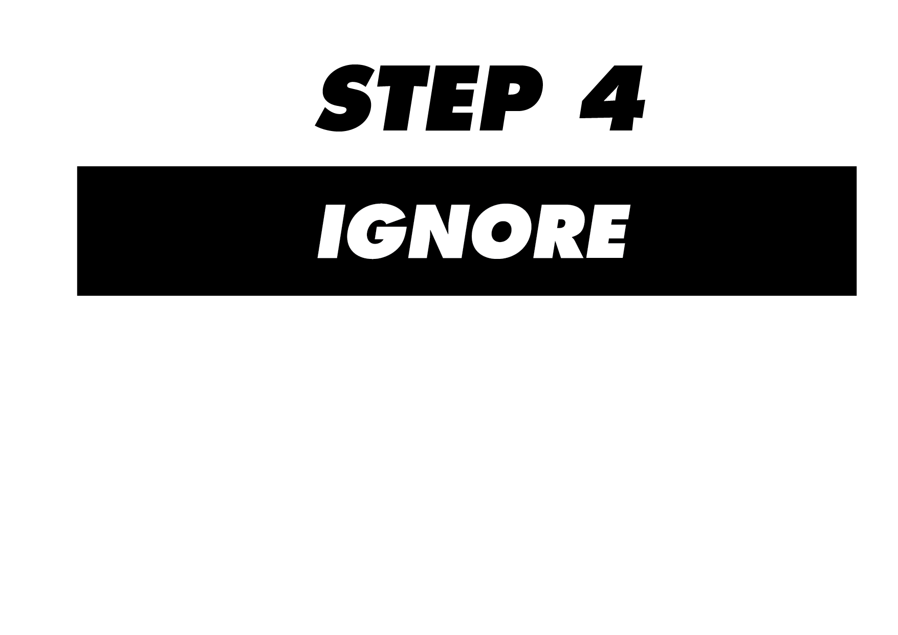
It is vital to ignore hybrid trolls and not enter into further engagement, for several reasons:
The more users engage with trolls, the more credible they become in the eyes of inexperienced users
The more replies trolls receive, the more ‘clicks’ they will receive in the future (the snowball effect), even the negative reactions can serve the purpose of the troll
Any reaction can serve for provocation in the future (subjectively selected excerpts can be used as a generalisation of “real views” by propaganda channels).

